Slide 1
Fresheat
@terfno

Slide 2
Fresheat
@terfno
あ、二言語(en/ja)に対応してます。

Slide 3
agenda
what is fresheat
why fresheat
design
estimate
database
server side
front
deploy
demo

Slide 4
what is fresheat

Slide 5
what is fresheat
It is an application that changes your seat to something nice.

Slide 6
what is fresheat
It is an application that changes your seat to something nice.
Hold past seat information and carry out seat replacement without duplication.

Slide 7
what is fresheat
It is an application that changes your seat to something nice.
Hold past seat information and carry out seat replacement without duplication.
You can also browse past seat information.

Slide 8
what is fresheat
It is an application that changes your seat to something nice.
Hold past seat information and carry out seat replacement without duplication. ← probably implemented
You can also browse past seat information.

Slide 9
what is fresheat
It is an application that changes your seat to something nice.
Hold past seat information and carry out seat replacement without duplication. ← probably implemented
You can also browse past seat information. ← unimplemented

Slide 10
why fresheat

Slide 11
why fresheat
Just

Slide 12
why fresheat
Just for

Slide 13
why fresheat
Just for FUN

Slide 14
why fresheat
Just for FUN (ツ)

Slide 15
design

Slide 16
design
just do it.

Slide 17

design
just do it.
just like →

Slide 18
design
just do it.
just like →
from: https://voyagegroup.com/internship/treasure/

Slide 19
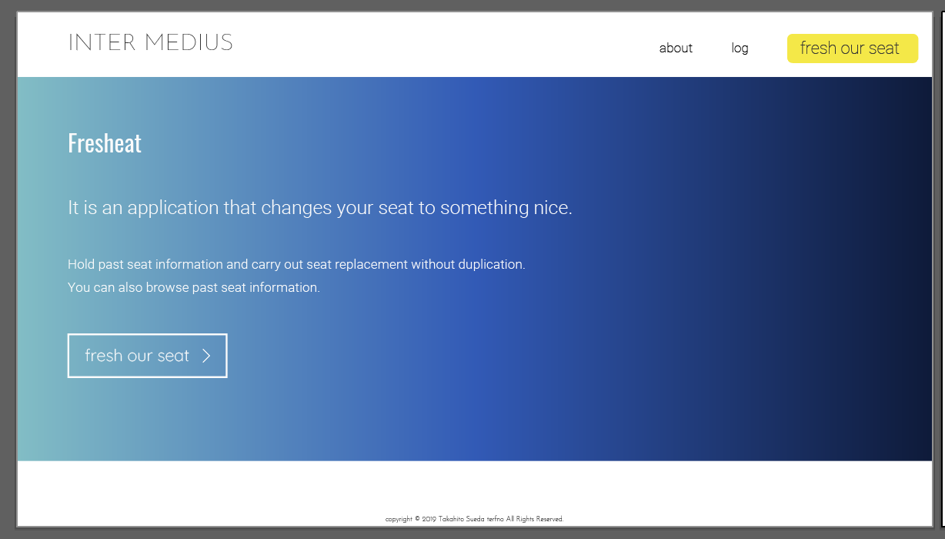
design
just do it.

Slide 20
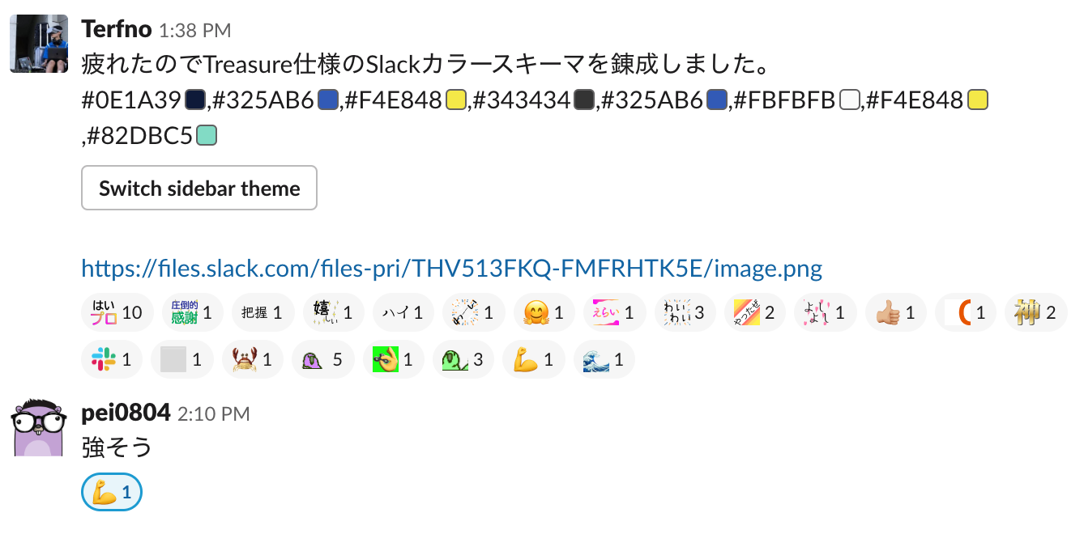
design

Slide 21
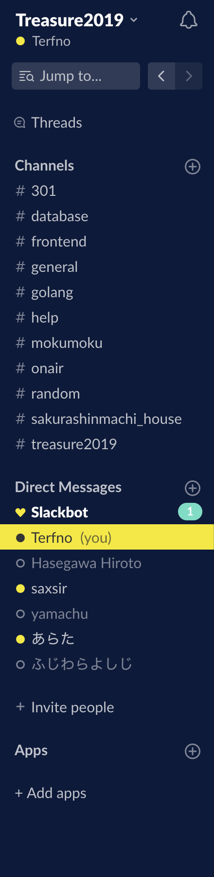
design

Slide 22
estimate

Slide 23
estimate(?)

Slide 24
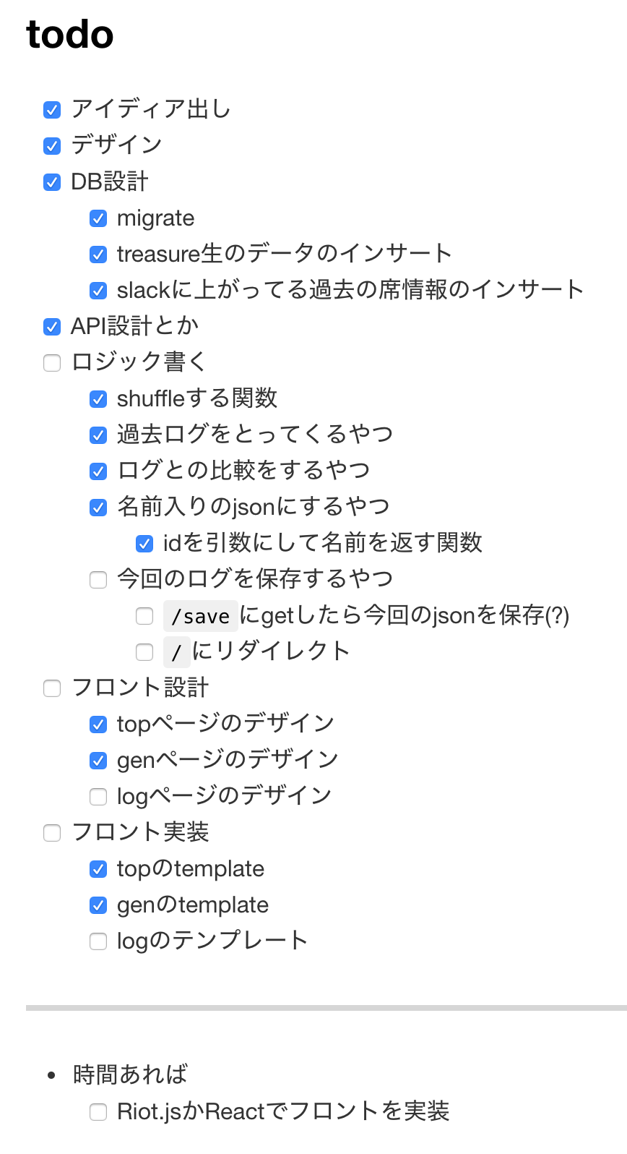
estimate(?)
from my daily report

Slide 25
estimate(?)
I really should have done this.

Slide 26
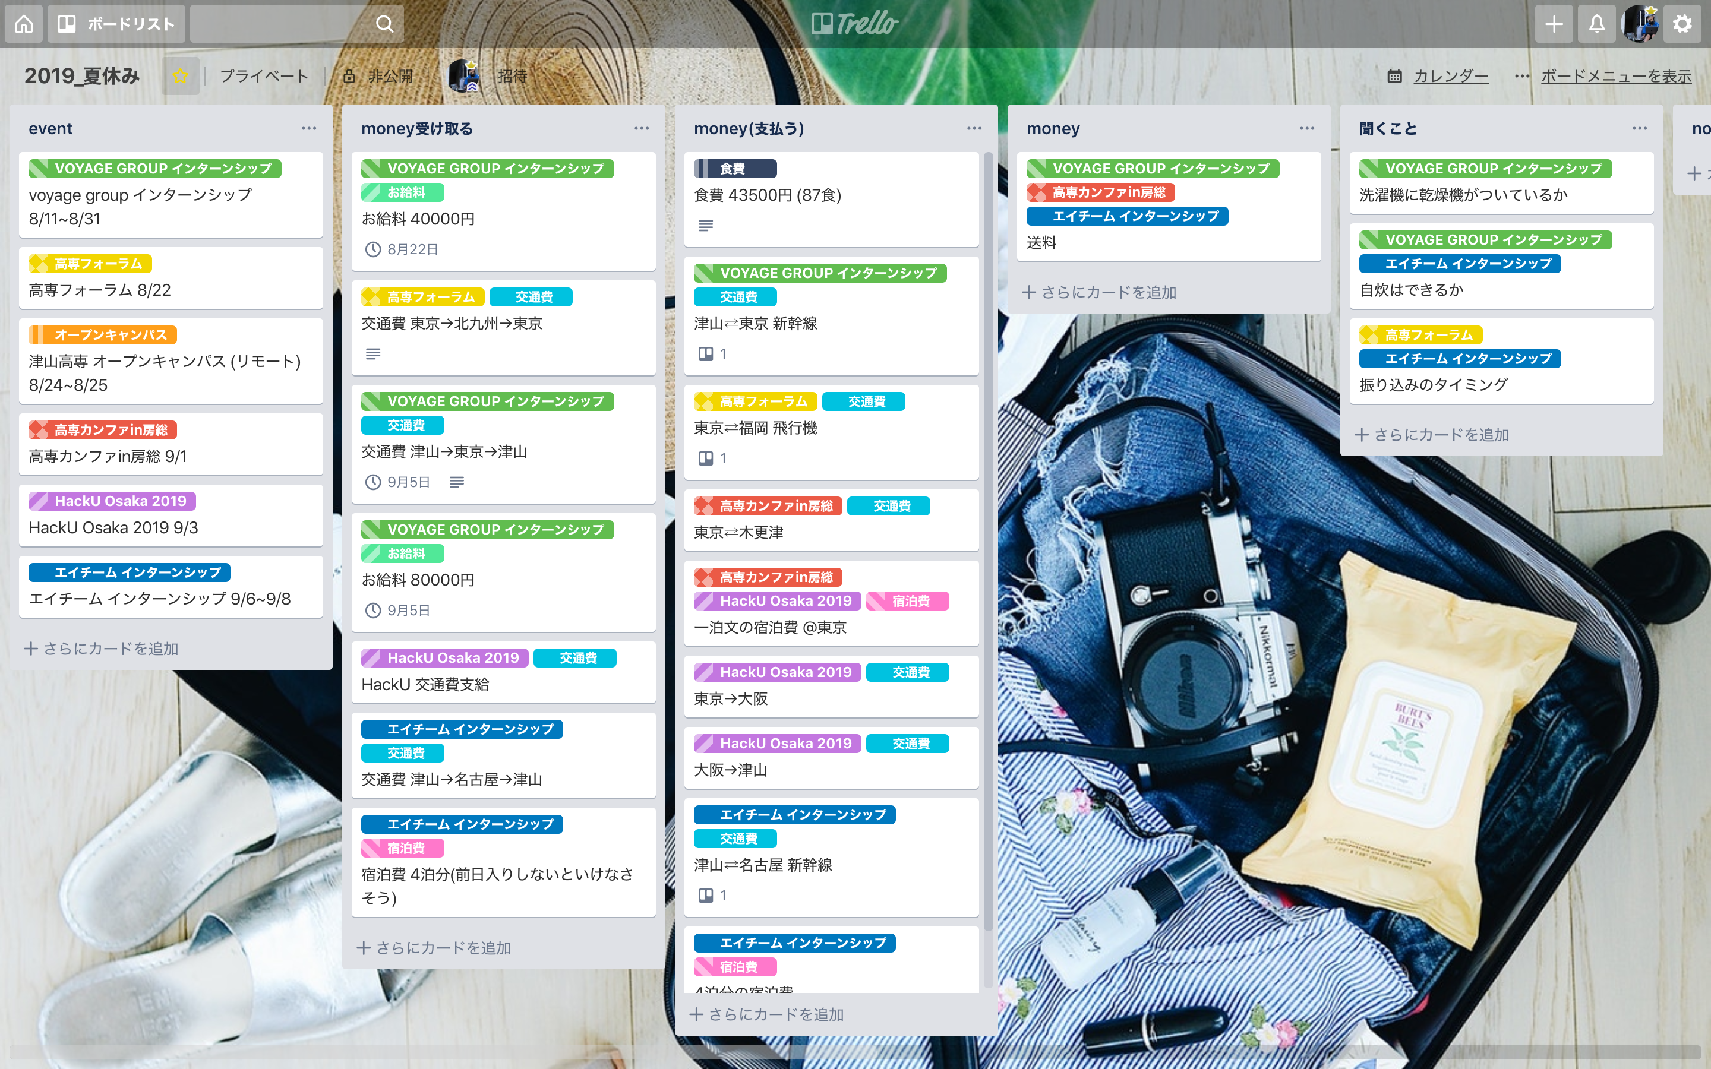
estimate(?)
I really should have done this.

Slide 27
estimate(?)
I love Trello.

Slide 28
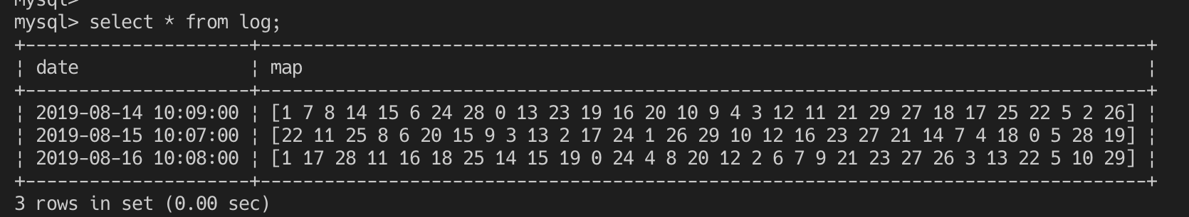
database
old seat log↓

Slide 29
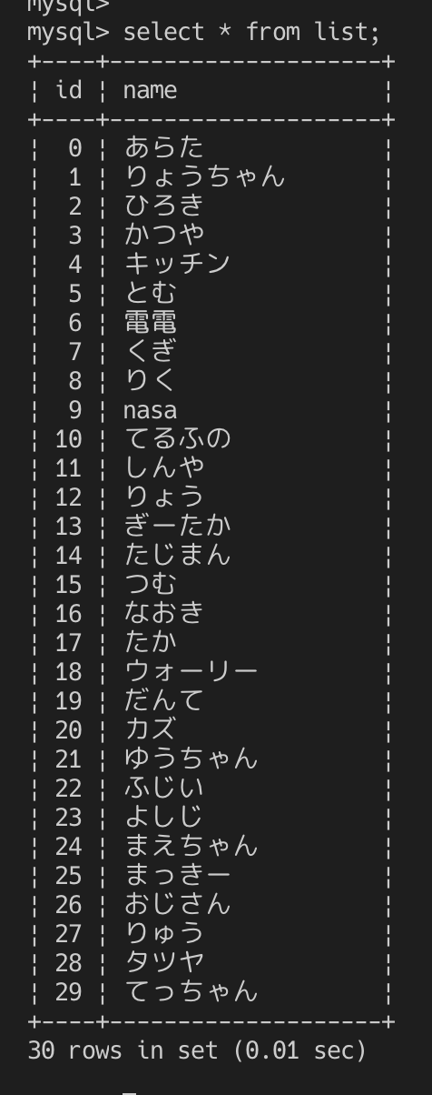
database
treasure member list→

Slide 30
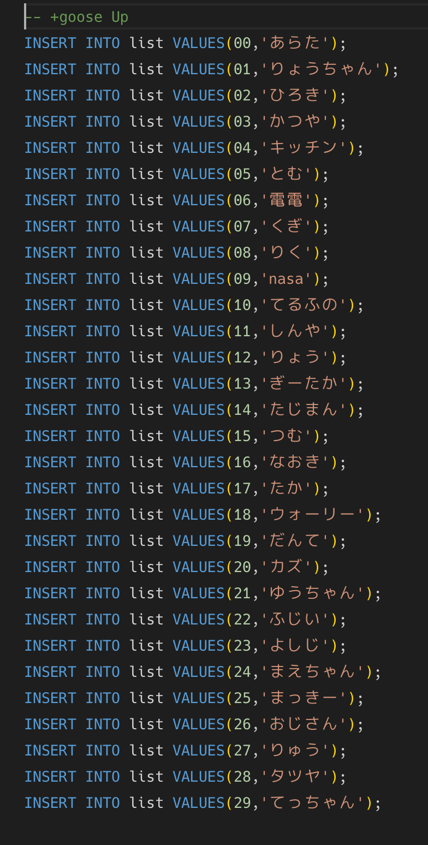
database
migration→

Slide 31
database
migration→
😇

Slide 32
server side
use :gopher:
it was fun.

Slide 33
front
import “text/template”

Slide 34
front
😇

Slide 35
deploy
I was going to deploy with now.sh

Slide 36
demo

